Slide 1
Regularization

Slide 2

Regularization?
Main purpose is to avoid “OverFitting”
http://www.freedomsquare.co.kr/2347#.VvELE-KLQuU

Slide 3
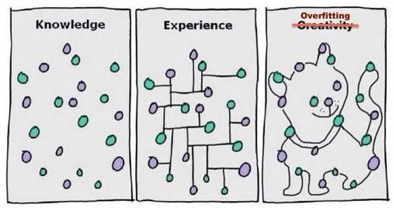
OverFitting
This actually happens all the time!

Slide 4
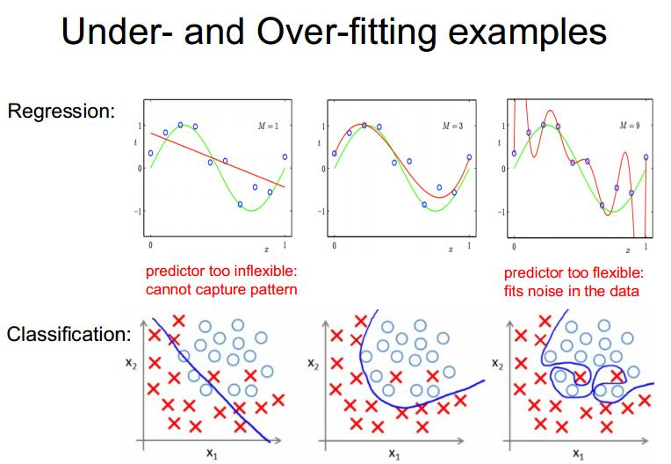
Examples

Slide 5
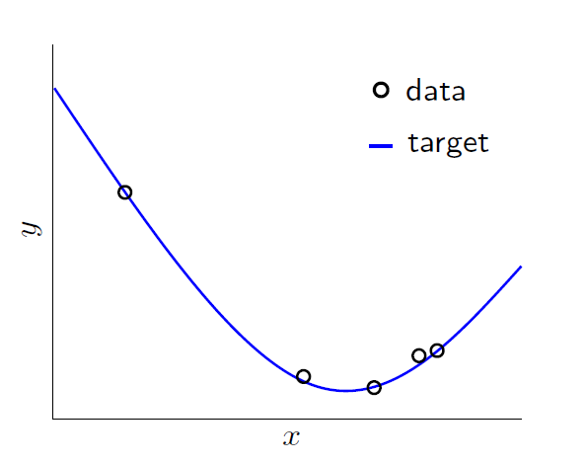
OverFitting
Literally, Fitting the data more than is warranted

Slide 6
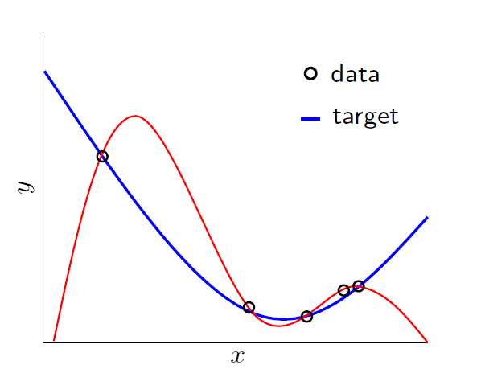
OverFitting
Literally, Fitting the data more that is warranted

Slide 7
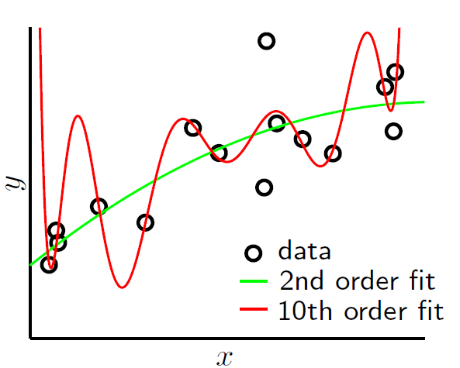
OverFitting
Things get worse with noise!

Slide 8

Stochastic Noise
Comes from random measurement error

Slide 9

Deterministic Noise
Cannot model this type of error

Slide 10
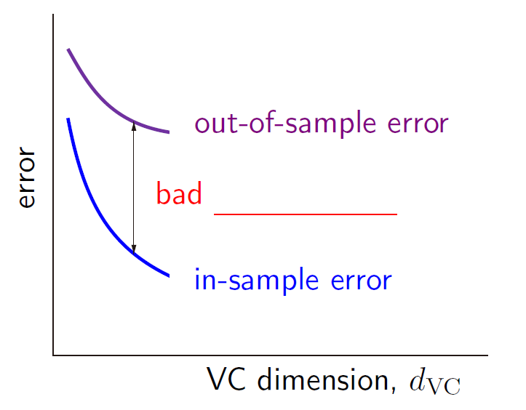
Mathematically,
Test error
Generalization performance
Training error
Complexity of the algorithm

Slide 11
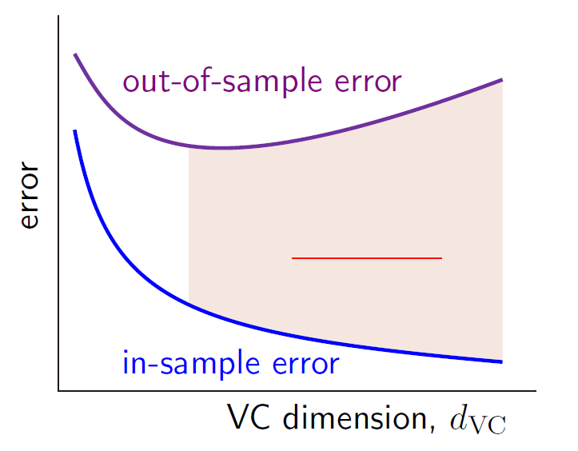
Mathematically,
Over fitting

Slide 12



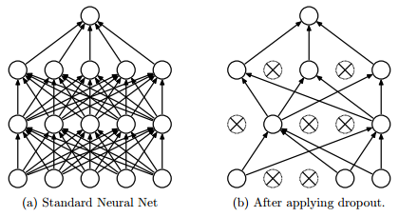
Preventing OverFitting?
Approach 1: Get more data
Approach 2: Use a model with the right capacity
Approach 3: Average many different models (Ensemble)
Approach 4: Use DropOut, DropConnect, or BatchNorm

Slide 13

Limiting the Capacity
Architecture: Limit the number of hidden layers and units per layer
Early stopping: Stop the learning before it overfits using validation sets
Weight-decay: Penalize large weights using penalties or constraints on their squared values (L2 penalty) or absolute values (L1 penalty)

Slide 14
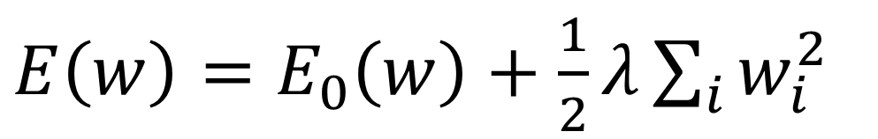
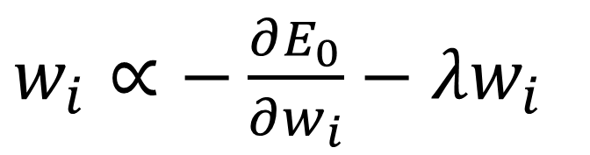
Weight Decay
$E\left(w\right)=E_{0}\left(w\right)+\frac{1}{2}λ\sum_{i}{w_{i}^{2}}$
$w_{i}∝−\frac{∂E_{0}}{∂w_{i}}−λw_{i}$
Anders Krogh and John A Hertz , "A simple weight decay can improve generalization." NIPS, 1995

Slide 15
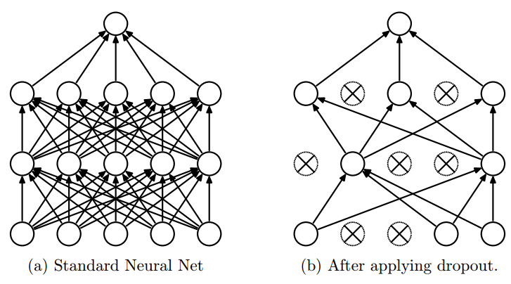
DropOut
DropOut increases the generalization performance of the neural network by restricting the model capacity!
Srivastava, Nitish, et al. "Dropout: A simple way to prevent neural networks from overfitting." The Journal of Machine Learning Research 15.1 (2014): 1929-1958.

Slide 16
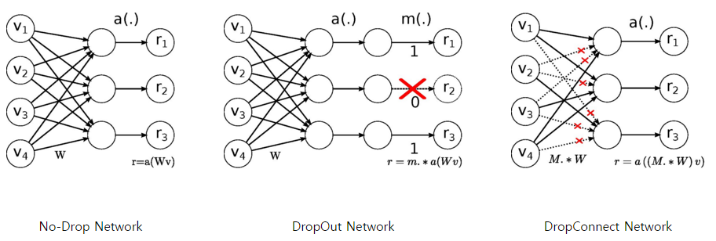
DropConnect
Instead of turning the neurons off (DropOut), DropConnect disconnects the connections between neurons.
Li Wan, Matthew Zeiler, Sixin Zhang, Yann LeCun, Rob Fergus "Regularization of neural networks using DropConnect.“ ICLML, 2013.

Slide 17
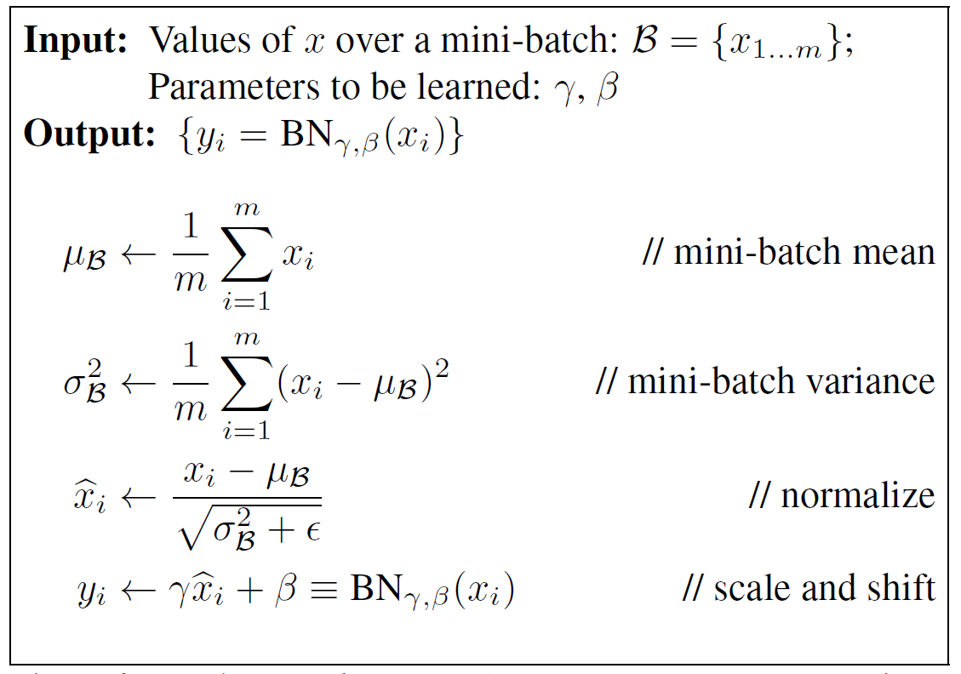
Batch Normalization
Benefits of BN
1. Increase learning rate
2. Remove Dropout
3. Reduce L2 weight decay
4. Accelerate learning rate decay
5. Remove Local Response Normalization

Slide 18

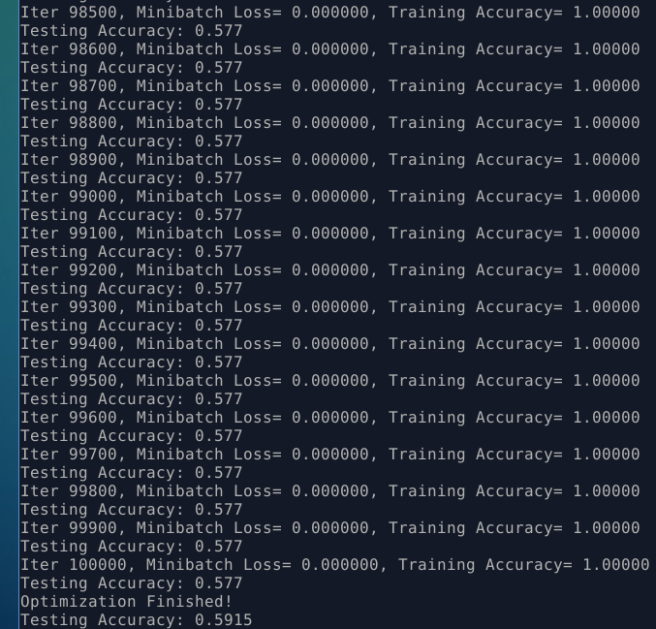

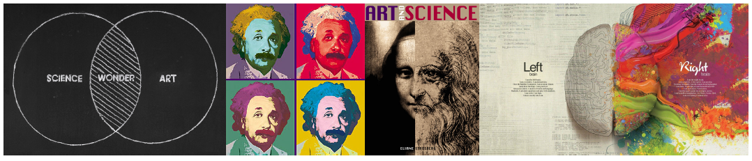
Conclusion

